Slide 1
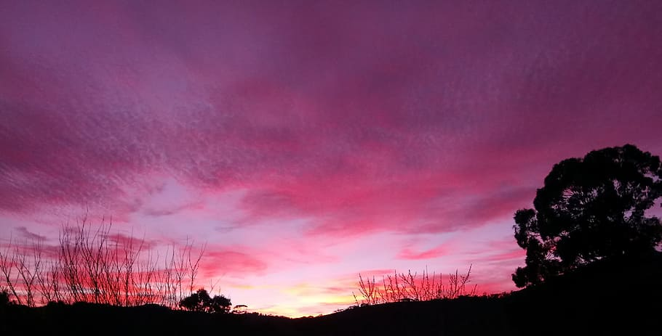
I Stand Amazed
我赞叹我主奇妙

Slide 2
I stand amazed in the presence
Of Jesus the Nazarene
And wonder how He could love me
A sinner, condemned, unclean
我站在拿撒勒人耶稣面前赞叹，
想知道他为什么会爱我，
一个不洁净，被定罪的罪人。

Slide 3
O how marvelous! O how wonderful!
And my song shall ever be:
O how marvelous! O how wonderful!
Is my Savior’s love for me!
哦，多么奇妙！哦，多么美好！
我的歌声将永远是：
哦，多么奇妙！哦，多么美好！
赞美救主对我的大慈爱！

Slide 4
He took my sins and my sorrows
He made them His very own;
He bore the burden to Calvary
And suffered and died alone。
他背负了我的罪孽和悲伤，
他将世人的罪放在他自己身上；
他背负着这重担上骷髅地，
独自受苦替我死。

Slide 5
O how marvelous! O how wonderful!
And my song shall ever be:
O how marvelous! O how wonderful!
Is my Savior’s love for me!
哦，多么奇妙！哦，多么美好！
我的歌声将永远是：
哦，多么奇妙！哦，多么美好！
赞美救主对我的大慈爱！

Slide 6
When with the ransomed in glory
His face I at last shall see
Twill be my joy through the ages
To sing of His love for me。
当被赎回的我
最终看到我主荣面时，
将是我的盼望已久的喜乐
我要歌唱祂的大慈爱。

Slide 7
O how marvelous! O how wonderful!
And my song shall ever be:
O how marvelous! O how wonderful!
Is my Savior’s love for me!
哦，多么奇妙！哦，多么美好！
我的歌声将永远是：
哦，多么奇妙！哦，多么美好！
赞美救主对我的大慈爱！

Slide 8
O how marvelous! O how wonderful!
And my song shall ever be:
O how marvelous! O how wonderful!
Is my Savior’s love for me!
哦，多么奇妙！哦，多么美好！
我的歌声将永远是：
哦，多么奇妙！哦，多么美好！
赞美救主对我的大慈爱！

